Slide 1
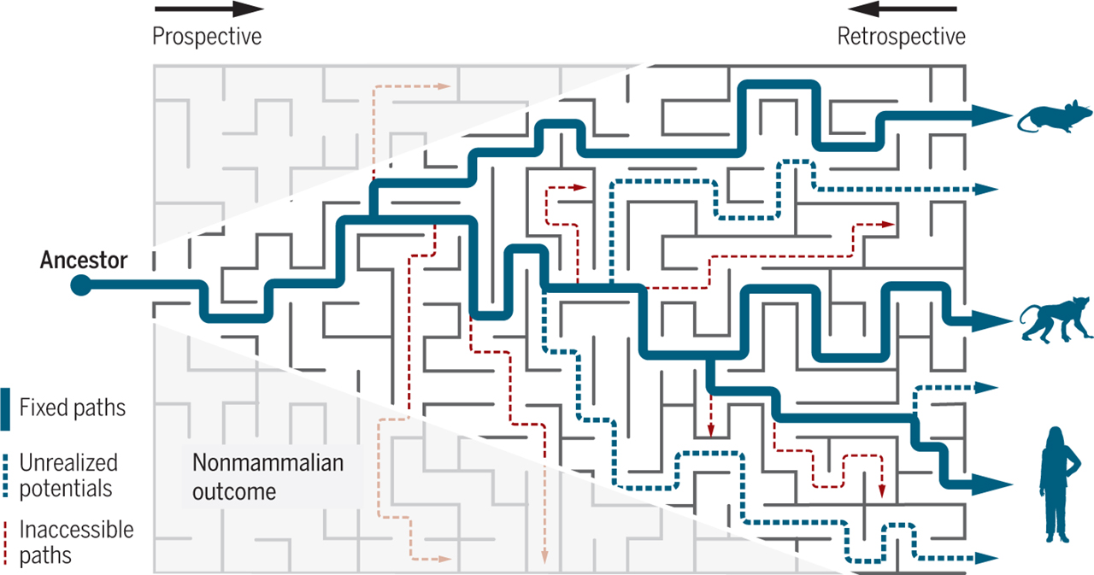
Molecular Evolution
Md Mazedul Haq

Slide 2
Darwin’s Theory of Evolution
A basic assumption of the Darwinian theory is that
new mutations, both advantageous and deleterious,
constantly arise in the population independent of
need, and evolution is caused by natural selection acting through beneficial mutations by fixing them in the population.
Darwinian evolution does not consider neutral mutations that do not confer any selective advantage or disadvantage to be of any importance in the evolutionary process.
This long-held view of Darwinian evolution was challenged by the neutral theory of molecular evolution.

Slide 3
What is Molecular Evolution ?
Molecular evolution address two broad range of
questions:
1. Use DNA to study the evolution of organisms,
e.g. population structure, geographic variation
and phylogeny
2. Use different organisms to study the evolution process of DNA

Slide 4
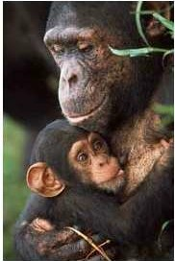
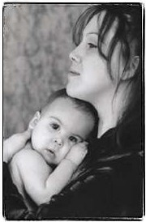
Molecular Evolution
Moiphological Similarity
Genetic
Similarity
-distance between humans and chimpanzees is less than between sibling species of Drosophila.
low
high
-for example, from a sample of 11proteins representing 1271 amino acids, only 5 differ between human and chimp.
-the other six proteins are identical in primary structure.
- most proteins that have been sequenced exhibit no amino acid differences - e.g., alphaglobin
Pan, Chimp
Honw,Hmnan

Slide 5
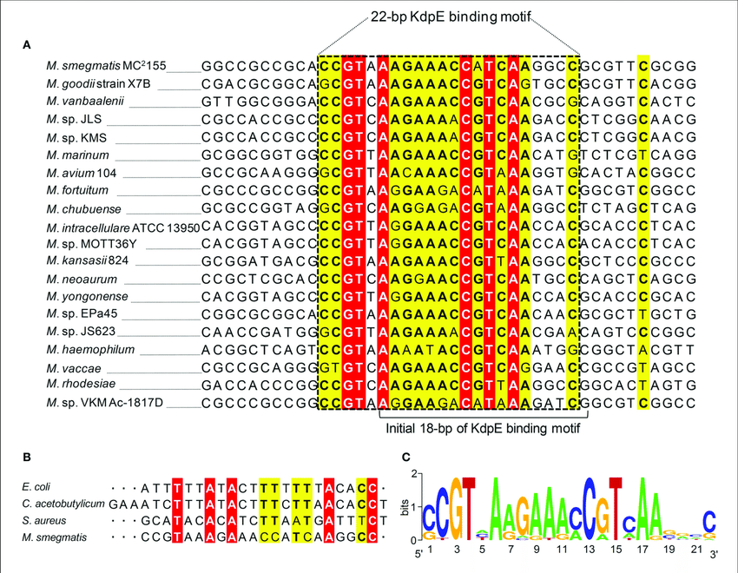
Sequence Alignment

Slide 6
Mutations in DNA and protein
Synonymous mutation -> do not change amino acid
Nonsynonymous mutation -> change amino acid
Nonsense mutation: point mutation resulting in a pre-mature stop codon
Missense mutation: resulting in a different amino acid
Frameshift mutation: insertion / deletion of 1 or 2 nucleotides
Silent mutation: same as nonsynonymous mutation
Neutral mutation: has no fitness effects, invisible to evolution (neutrality usually hard to confirm)
Deleterious mutation: has detrimental fitness effect
*Fitness = ability to survive and reproduce

Slide 7
Consider molecular evolutionary changes
at two levels
Changes in DNA;
Point mutation; mutations of single genes; small alterations in sequence or number of nucleotides
Chromsomal mutations; alterations that are more extensive than point mutations; four types – deletions duplications, inversions, translocations
scope extends from point mutations in introns or exons, to changes in the size and composition of genomes
Changes in gene products;
RNA
Proteins…polypeptide chains…amino acid sequences

Slide 8
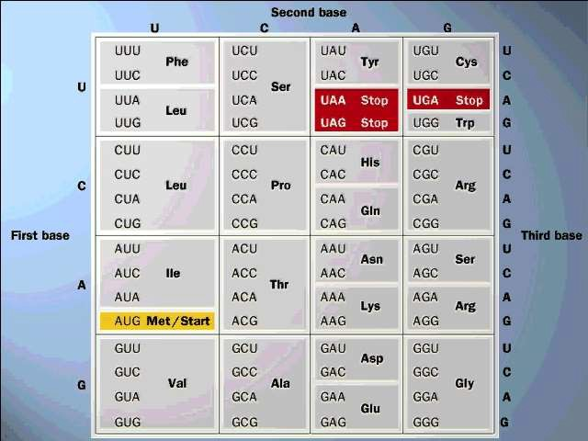
Degeneracy of genetic code
•Because there are only 20 amino acids, but 64 possible codons, the same amino acid is often encoded by a number of different codons, which usually differ in the third base of the triplet.
•Because of this repetition the genetic code is said to be degenerate and codons which produce the same amino acid are called synonymous codons.

Slide 9
Negative Selection and Positive Selection
Negative selection (purifying selection)
Selective removal of deleterious mutations (alleles)
Result in conservation of functionally important amino acids
Examples: ribosomal proteins, RNA polymerase, histones
Positive selection (adaptive selection, Darwinian selection)
Increase the frequency of beneficial mutations (alleles) that increase fitness (success in reproduction)
Examples: male seminal proteins involved in sperm competition,
membrane receptors on the surface of innate immune system
Classic examples: Darwin’s finch, rock pocket mice in Arizona (however the expression level of these genes instead of their protein sequence are targeted by selection)

Slide 10
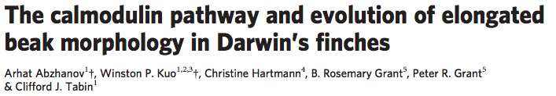
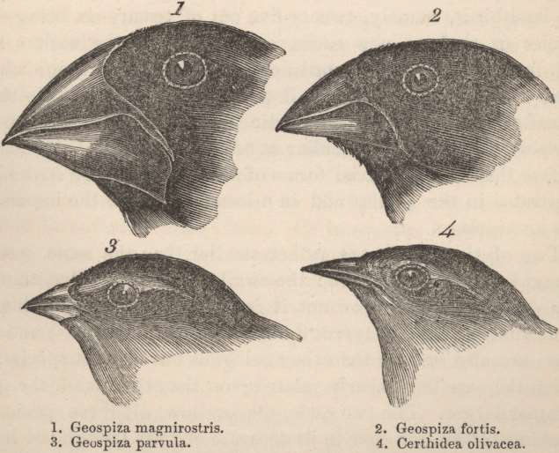
“They show that calmodulin (CaM), a molecule involved in mediating Ca²⁺ signalling, is expressed at higher levels in the long and pointed beaks of cactus finches than in more robust beak types of other species.”
Nature 2006

Slide 11
Purifying (negative) Selection
Seq1 | AAG | ACT | GCC | GGG | CGT | ATT
Seq2 | AAA | ACA | GCA | GGA | CGA | ATC
Seq1 | K | T | A | G | R | I
Seq2 | K | T | A | G | R | I
# Synonymous substitutions = 6
# Non-synonymous substitutions = 0
Ka / Ks
= Non-synonymous / Synonymous substitutions
= 0

Slide 12
Neutral Selection
Seq1 | AAG | ACT | GCC | GGG | CGT | ATT
Seq2 | AAA | ACA | GAC | GGA | CAT | ATG
Seq1 | K | T | A | G | R | I
Seq2 | K | T | D | G | H | M
# Synonymous substitutions = 3
# Non-synonymous substitutions = 3
Ka / Ks
= Non-synonymous/Synonymous substitutions
= 1

Slide 13
Positive Selection
Seq1 | AAG | ACT | GCC | GGG | CGT | ATT
Seq2 | AAA | ATT | GAC | GAG | CAT | ATG
Seq1 | K | T | A | G | R | I
Seq2 | K | I | D | E | H | M
# Synonymous substitutions = 1
# Non-synonymous substitutions = 5
Ka / Ks
= Non-synonymous/Synonymous substitutions
=5

Slide 14
Synonymous substitutions are NOT
always neutral
Different codons for the same amino acid may have different
functional constraints and fitness effects
Translational efficiency: codon usage bias
RNA stability and correct folding of secondary structures
RNA editing
Protein folding
Exon splicing regulatory motifs
Binding sites for microRNA and RNA binding proteins (RBP)

Slide 15
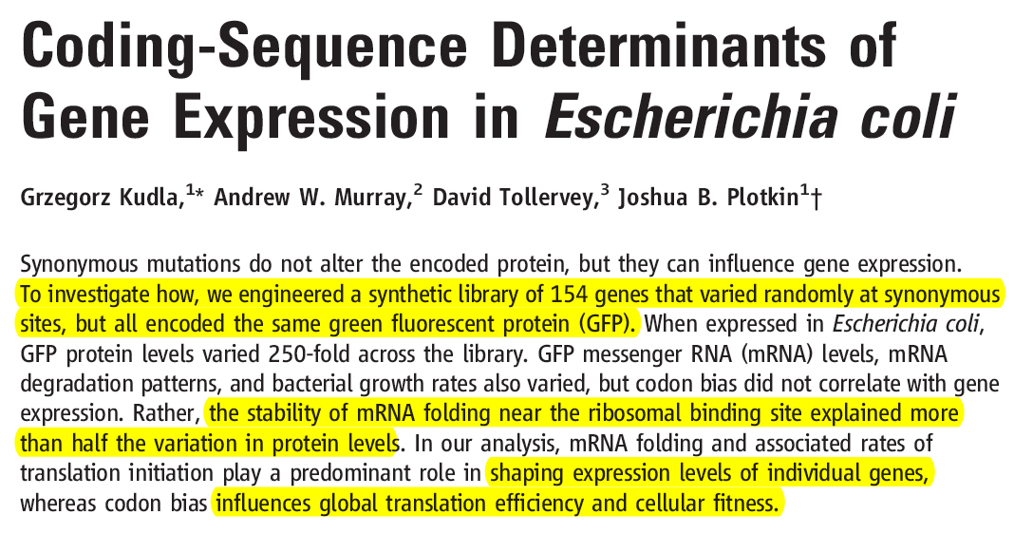
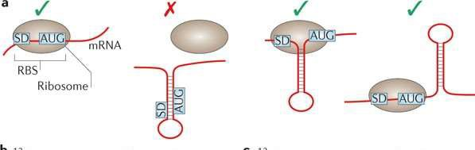
Synonymous codons influence mRNA secondary
structure and gene expression
Slotkin Kudla Nat Rev Gen, 2011

Slide 16
The Neutral Theory of Molecular Evolution
Motoo Kimura advanced the Neutral Theory of Molecular Evolution in 1968. Two observations underlie the theory
1. Most natural populations harbor high levels of genetic variation higher than would be expected if natural selection were the evolutionary force primarily responsible for influencing the level of genetic variation in populations
2. Many mutations in sequences of genes do not alter the proteins encoded by those genes
virtually always true for synonomous substitutions
sometimes true for non-synonomous substitutions
If protein function is not altered by a mutation, the allelic variant that results from that mutation is unlikely to be influenced by natural selection…

Slide 17
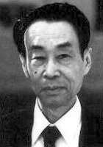
Neutral theory of evolution
Using sequence data of hemoglobin, insulin, cytochrome c from many vertebrates, Motoo Kimura calculated on average sequence evolution in mammals had been very rapid: 1 amino acid change every 1.8 years
Such a high mutation frequency suggest the majority of substitutions have no fitness effects, i.e. selectively neutral, and are created by genetic drift.
Rate of molecular evolution is equal to the neutral mutation rate, this gives rise to the concept of “molecular clock”

Slide 18
“The Neutralist-Selectionist debate”
Agree:
Most mutations are deleterious and are removed.
Some mutations are favourable and are fixed.
Neutral theory
Advantageous (adaptive) mutations are very rare
Most of the amino acid changes and polymorphisms are
neutral, and created by genetic drift.
The concept of Molecular clock
Selectionist theory
Advantageous mutations are more common
Molecular evolution are dominated by selection
No Molecular clock

Slide 19
Evidence supporting neutral evolution
Pseudogenes (dead genes that have no function and no fitness
effect) evolve very fast.
Synonymous codon positions (3-fold, 4-fold degenerate sites) evolve faster than non-synonymous sites, and should evolve with a constant rate. (not always true, see previous slides)
Genes that have important functions should evolve slower.

Slide 20

The
Molecular Clock
Hypothesis
The molecular clock is figurative term for a technique that uses the mutation rate of biomolecules to deduce the time in prehistory when two or more life forms diverged.
Amount of genetic difference between sequences is a function of time since separation.
Rate of molecular change is constant (enough) to
predict times of divergence
It is sometimes called a gene clock or an evolutionary clock.

Slide 21
Outline
Methods for estimating time under a molecular clock
Estimating genetic distance
Determining and using calibration points
Sources of error
Rate heterogeneity
reasons for variation
how its taken into account when estimating times
Reliability of time estimates
Estimating gene duplication times

Slide 22
Measuring Evolutionary time with a molecular clock
Estimate genetic distance
d = number amino acid replacements
Use paleontological data to determine date of common ancestor
T = time since divergence
Estimate calibration rate (number of genetic changes expected per unit time)
r = d / 2T
Calculate time of divergence for novel sequences
T= d/ 2r

Slide 23
Five factors combine to limit the application of molecular clock models:
Changing generation times (If the rate of new mutations depends at least partly on the number of generations rather than the number of years)
Population size (Genetic drift is stronger in small populations, and so more mutations are effectively neutral)
Species-specific differences (due to differing metabolism, ecology, evolutionary history, ...)
Change in function of the protein studied (can be avoided in closely related species by utilizing non-coding
DNA sequences or emphasizing silent mutations)
Changes in the intensity of natural selection.

Slide 24
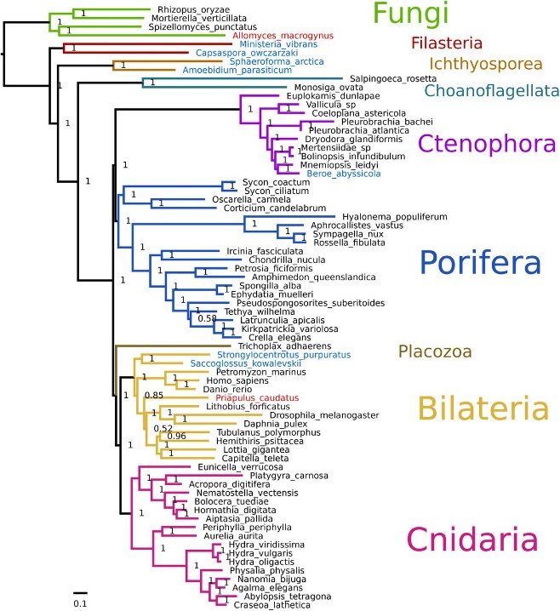
Applying a Molecular Clock: The Origin
of HIV
Phylogenetic analysis shows that HIV is descended from viruses that infect chimpanzees and other primates
HIV spread to humans more than once
Comparison of HIV samples shows that the virus evolved in a very clocklike way
Application of a molecular clock to one strain of HIV suggests that that strain spread to humans during the 1930s

Slide 25
Genome Evolution
Orthologous genes are widespread and extend across many widely varied species
For example, humans and mice diverged about 65 million years ago, and 99% of our genes are orthologous
Gene number and the complexity of an organism are not strongly linked
For example, humans have only four times as many genes as yeast, a single-celled eukaryote
Genes in complex organisms appear to be very versatile, and each gene can perform many functions

Slide 26
Phylogenetic trees
Phylogeny is the evolutionary history of a
species or group of related species
Taxonomy is the ordered division and naming of organisms
A taxonomic unit at any level of hierarchy is called a taxon
Systematists depict evolutionary relationships
in branching phylogenetic trees
A phylogenetic tree represents a hypothesis about evolutionary relationships

Slide 27
Each branch point represents the divergence of two species
Sister taxa are groups that share an immediate common ancestor
A rooted tree includes a branch to represent the
last common ancestor of all taxa in the tree
A basal taxon diverges early in the history of a group and originates near the common ancestor of the group
A polytomy is a branch from which more than two groups emerge

Slide 28
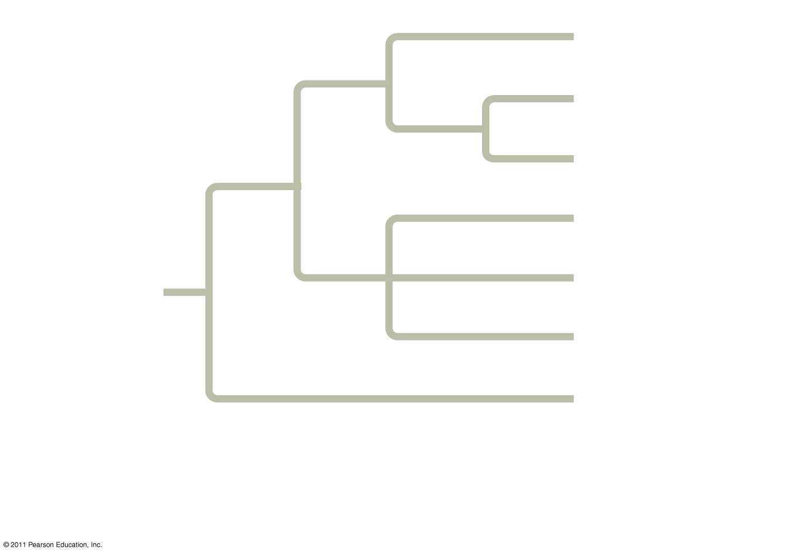
Branch point:
where lineages diverge
Taxon A
Taxon B
Sister
taxa
Taxon C
Taxon D
Taxon E
ANCESTRAL LINEAGE
Taxon F
Basal taxon
Taxon G
This branch point represents the common ancestor of taxa A–G.
This branch point forms a polytomy: an unresolved pattern of divergence.

Slide 29
Phylogenetic analysis using DNA sequence
Human
Human
Chimp
Chimp
Gorilla
Gorilla
Orangutan
Orangutan
Gibbon
Gibbon
Traditional
Molecular

Slide 30
Two Areas in Phylogenetic analysis
Phylogenetic inference or “tree building”:
To infer the branching orders and lengths between “taxa” ( or genes, populations, species etc).
For example, can DNA tell us giant panda more similar to bear or to dog, and when did they diverge ?
Character and rate analysis:
Using phylogeny as a framework to understand the evolution of traits or genes.
For example, is gene X under positive or purifying selection ?

Slide 31
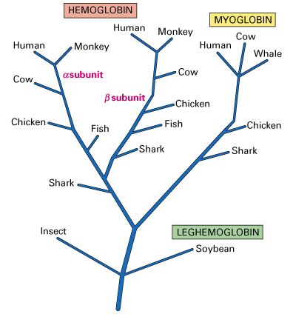
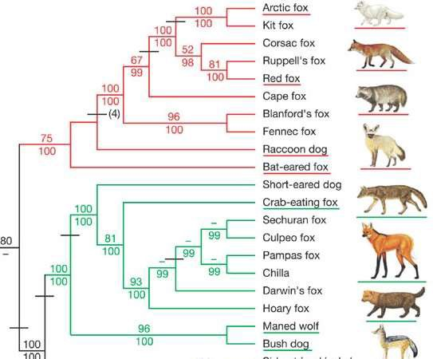
Phylogenetic Tree
Gene Tree
Species Tree
Lindblad-Toh Nature 2005
http://www.muhlenberg.edu/depts/biology/courses/bio152

Slide 32
Molecular evolution
Applications:
Molecular evolution analysis has clarified:
•the evolutionary relationships between humans and other primates;
•the origins of AIDS;
•the origin of modern humans and population migration;
•speciation events;
•genetic material exchange between species.
•origin of some deseases (cancer, etc...)

Slide 33
THANK YOU

